Slide 1
PCA
Principal component analysis

Slide 2
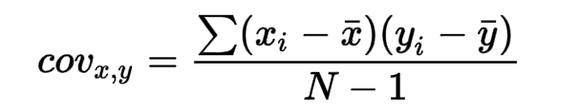
Steps
Standardize the data: PCA is sensitive to the scaling of the data, so it is recommended to standardize the data by subtracting the mean and dividing by the standard deviation for each feature.
Calculate the covariance matrix: The covariance matrix is a square matrix that shows the pairwise covariances between the features in the dataset. It can be calculated using the formula Cov(X) = (1/(n-1)) * (X - mu) * (X - mu)^T, where X is the standardized data matrix, mu is the mean vector of the data, and n is the number of observations.

Slide 3
Calculate the eigenvectors and eigenvalues of the covariance matrix: The eigenvectors and eigenvalues of the covariance matrix can be calculated using a technique called diagonalization. The eigenvectors represent the directions of maximal variation in the data, and the eigenvalues represent the magnitude of the variation along each eigenvector.
Sort the eigenvectors by eigenvalue: The eigenvectors can be sorted in descending order of their corresponding eigenvalues, so that the eigenvector with the highest eigenvalue represents the principal component that captures the most variation in the data.
Select the top k eigenvectors: The top k eigenvectors can be selected to form the k principal components that will be used to represent the original data in a lower-dimensional space.

Slide 4
Benefits of standardizing data
Standardizing the data matrix is an important step in PCA because the principal components are sensitive to the scale of the data. If the data is not standardized, a feature with a larger scale will dominate the analysis and have a stronger influence on the principal components.
We want to ensure that the principal components are based on the relative variation of the features rather than their absolute scale

Slide 5
Eigenvectors and eigenvalues
To get the eigenvectors of the covariance matrix, we can use a mathematical technique called diagonalization. Diagonalization involves finding a set of eigenvectors and eigenvalues that satisfy a certain equation involving the matrix. For a given matrix A, the eigenvectors and eigenvalues are defined by the equation:
A * v = λ * v
where v is the eigenvector, λ is the eigenvalue. This equation states that when the matrix A is multiplied by the eigenvector v, the result is a scaled version of the same eigenvector, with the scaling factor given by the eigenvalue λ.
- Equation to get eigenvalues det |A- λI|=0

Slide 6
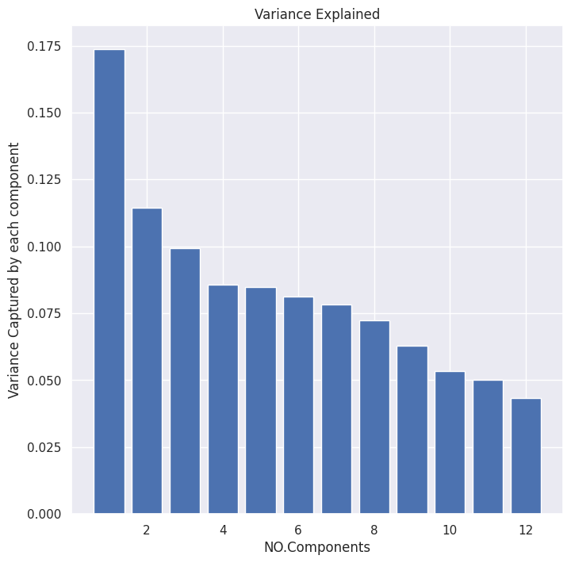
NinaPRO.

Slide 7

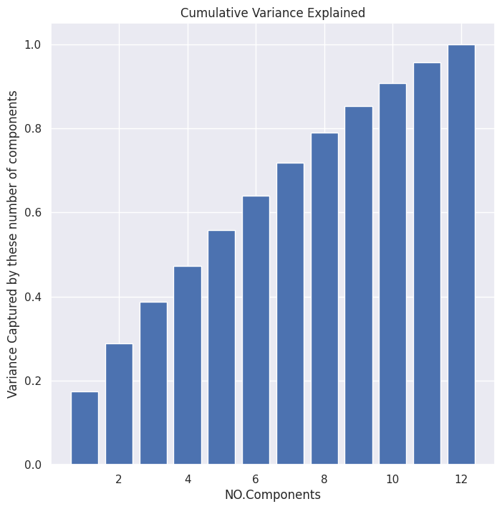

Slide 8
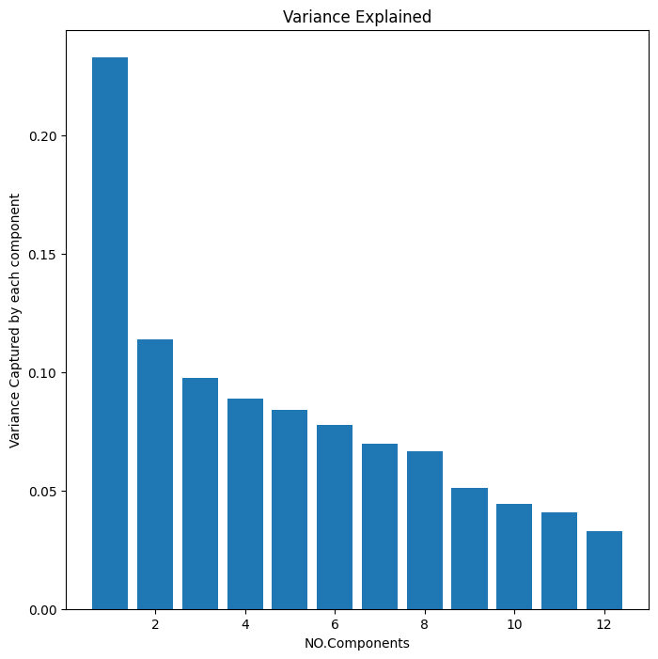
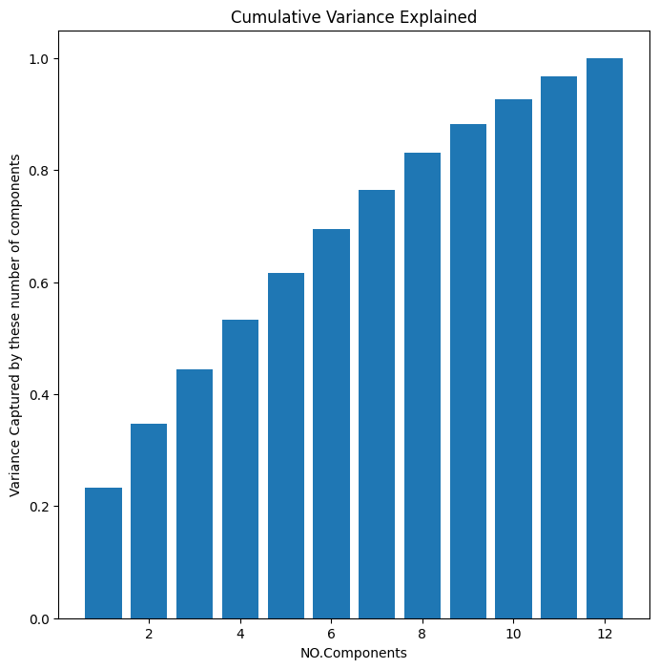
After separating the moves

Slide 9
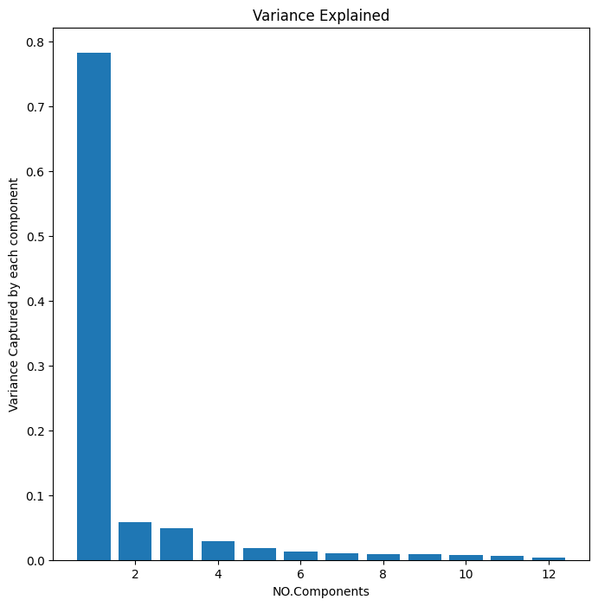
Using SR_index.mat

Slide 10
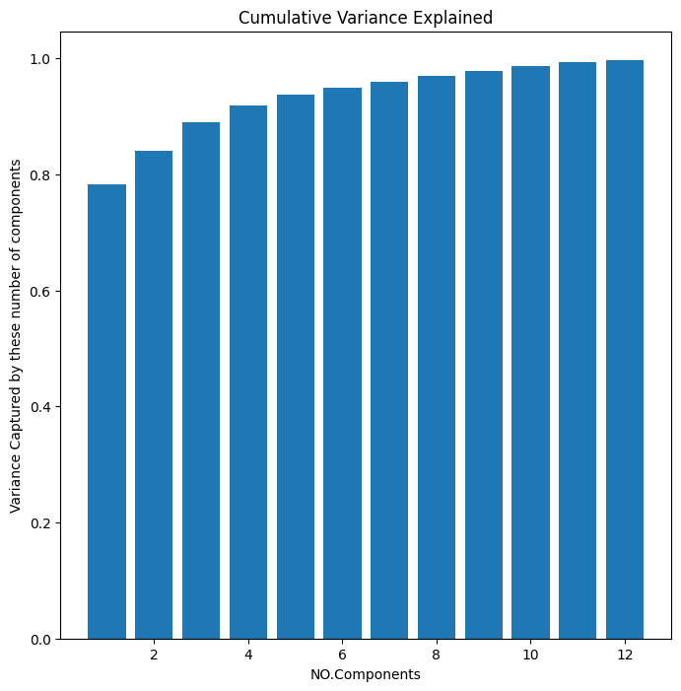

Slide 11
Resources
https://youtu.be/dz8imS1vwIM
https://youtu.be/dh8aTKXPKlU
https://youtu.be/S51bTyIwxFs
https://youtu.be/QdBy02ExhGI

Slide 12
CODE
https://colab.research.google.com/drive/1MLcaP-Znka6_zjyIZFF2XbvTvak2vdBd?usp=sharing

